Slide 1
DRUG RECOMMENDATION SYSTEM
19CSE453 Natural Language Processing
Team_No: 17
Project Advisor(s):
Ms. Kavitha C.R. & Mr. Nippunn Kumaar A.A./ Asst. Prof.(Sr.Gr.) CSE
S.No | Reg.No | Name of the Student | Section
1 | BL.EN.U4CSE20185 | T Aashritha Sri Vani | CSE C
2 | BL.EN.U4CSE20175 | Tata Kaushik | CSE C
3 | BL.EN.U4CSE20151 | Sai Srujan | CSE C

Slide 2
Problem Definition
To design Drug Recommendation System based on Sentiment Analysis of Drug Reviews using Natural Language Processing.

Slide 3
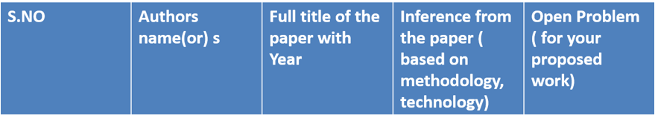
Literature Survey
 | Satvik Garg | Drug Recommendation System based on Sentiment Analysis of Drug Reviews using Machine Learning[2021] | Data Cleaning Feature Extraction Train test split using classifiers Smote Metrics | It still need improvements. It needs more optimization techniques to improve the accuracy. 93% accuracy
2 | Theresa Olubukola Omodunbi Grace Egbi Alilu Rhoda Nsikanabasi Ikono | Drug Recommender Systems: A Review of Stateof-the-Art Algorithms[2022] | DRSs which are information systems that recommend drug(s) to users based on their symptoms using sentiment analysis,ML and nlp | Denial to give feedbacks . Past medical history is not considered 82% accuracy.
1

Slide 4
Literature Survey
 | C. Srinivasa Kumar Ranga Swamy Sirisati Viswanath Gudditti Kanusu Srinivasa Rao Ratna Kumari Challa | A Smart Recommendation System for Medicine using Intelligent NLP Techniques[2022] | NLP Feature Extraction Vectorization Transformation | Still can be improved.
4 | Md. Deloar Hossain Md. Shafiul Azam Md Jahan Ali Hakilo Sabit | Drugs Rating Generation and Recommendation from Sentiment Analysis of Drug Reviews using Machine Learning[2020] | Mining sentiment information from social users’ reviews | It is working Successfully.
3

Slide 5
Literature Survey
 | Samayan Bhattacharya Avigyan Bhattacharya Sk Shahnawaz Asraful Islam | DrugPal: A Machine Learning Based Drug Recommender System To Assist Physician[2022] | Word2vec – vectorization LinearSVC – ML | Successfully working Future work is implementing it unsuperwisedly. 90% Accuracy
5

Slide 6
Software/Tools Requirements
Front End
HTML,CSS,JAVA SCRIPT
Back End
STREAMLIT
Python – For Building NLP Model

Slide 7
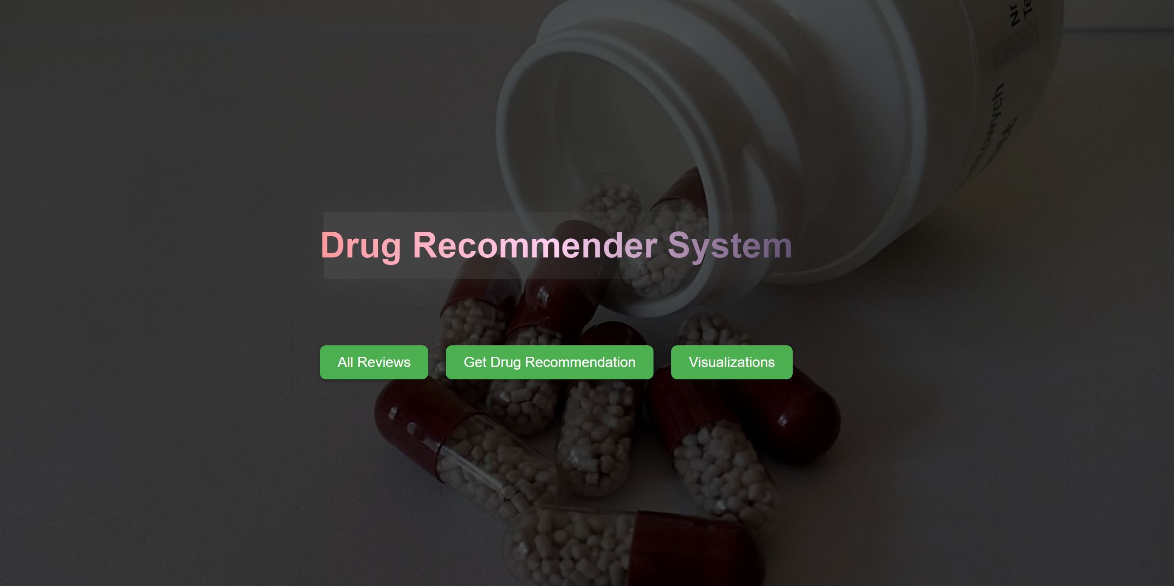
Architecture / Design
We created “home.html” page which is the start page of our project using HTML, CSS and JAVA SCRIPT. It has the following options and when clicked, it redirects to the corresponding page.

Slide 8
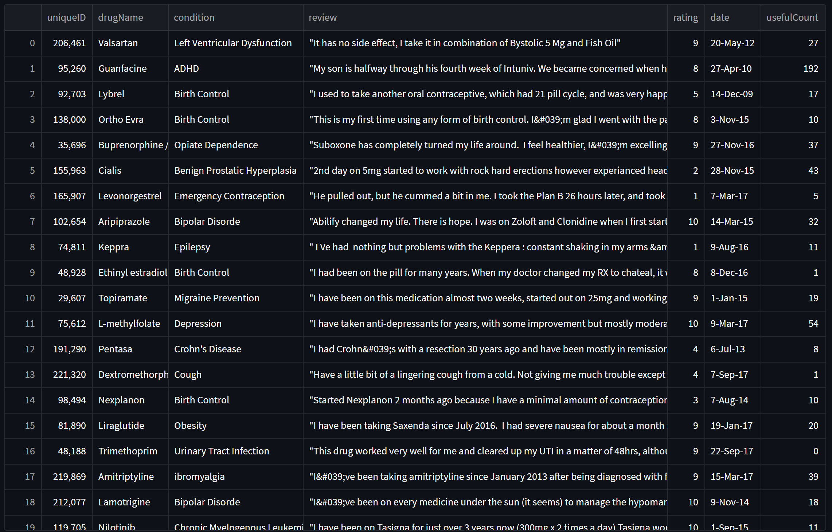
Architecture / Design
When the “All Reviews” button is clicked, it redirects us to a page where the original dataset is loaded using Streamlit

Slide 9
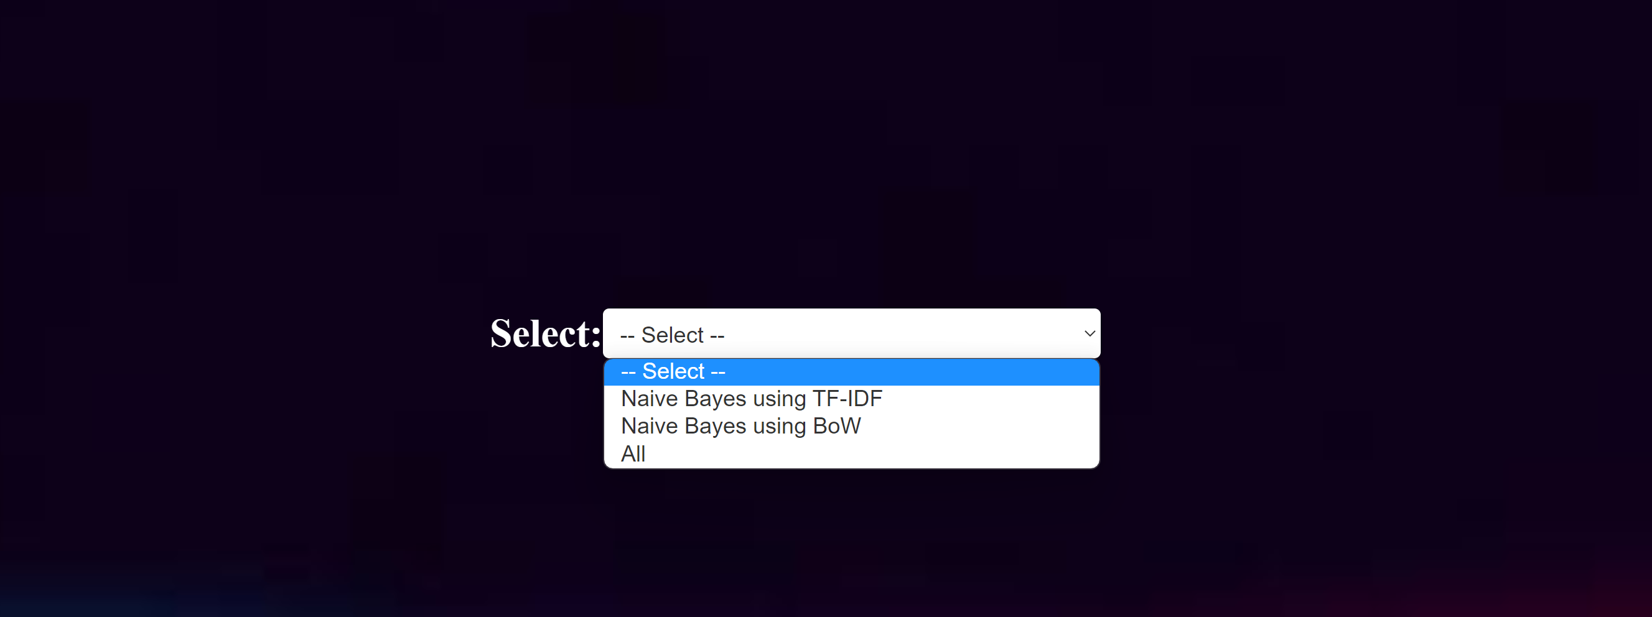
Architecture / Design
When the “Get Drug Recommendation” button is clicked, it redirects us to a page in which it asks for us to select a classifer. This page is done using HTML, CSS, STREAMLIT
After clicking on the corresponding classifier, it shows the drug recommendations calculated by the respective classifier.

Slide 10
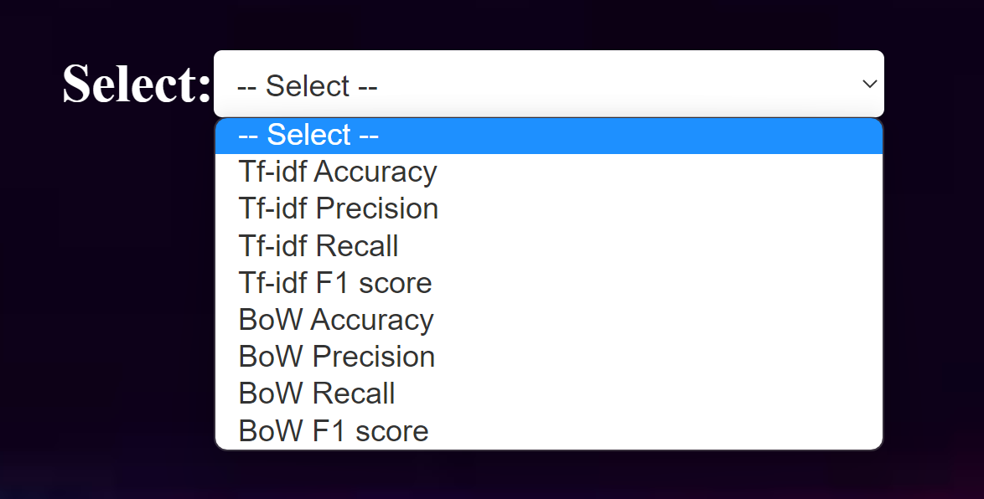
Architecture / Design
When the “Visualizations” button is clicked, it redirects us to a page where it asks us to select an option. After selecting, it plots the graph. This page is done using HTML, CSS, STREAMLIT

Slide 11
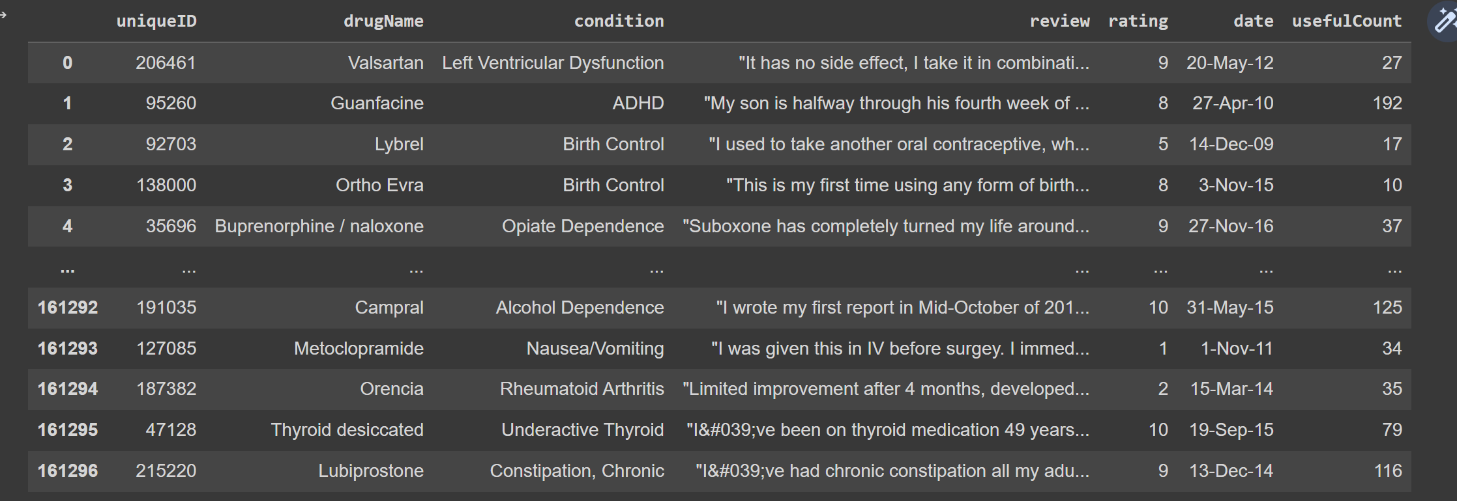
Data Set (If Applicable)
Source of data set: https://www.kaggle.com/datasets/jessicali9530/kuc-hackathon-winter-2018
Sample data set

Slide 12
Data set
Justification of why you are using this data set for your problem – Is its relevance to Your problem
Answer:
This drug dataset contains information about drugs, conditions, and patient reviews which is highly relevant to a drug recommendation problem as it provides insights into the effectiveness and suitability of different drugs for specific medical conditions.
This drug dataset can be used for training and evaluating machine learning models for drug recommendation.

Slide 13
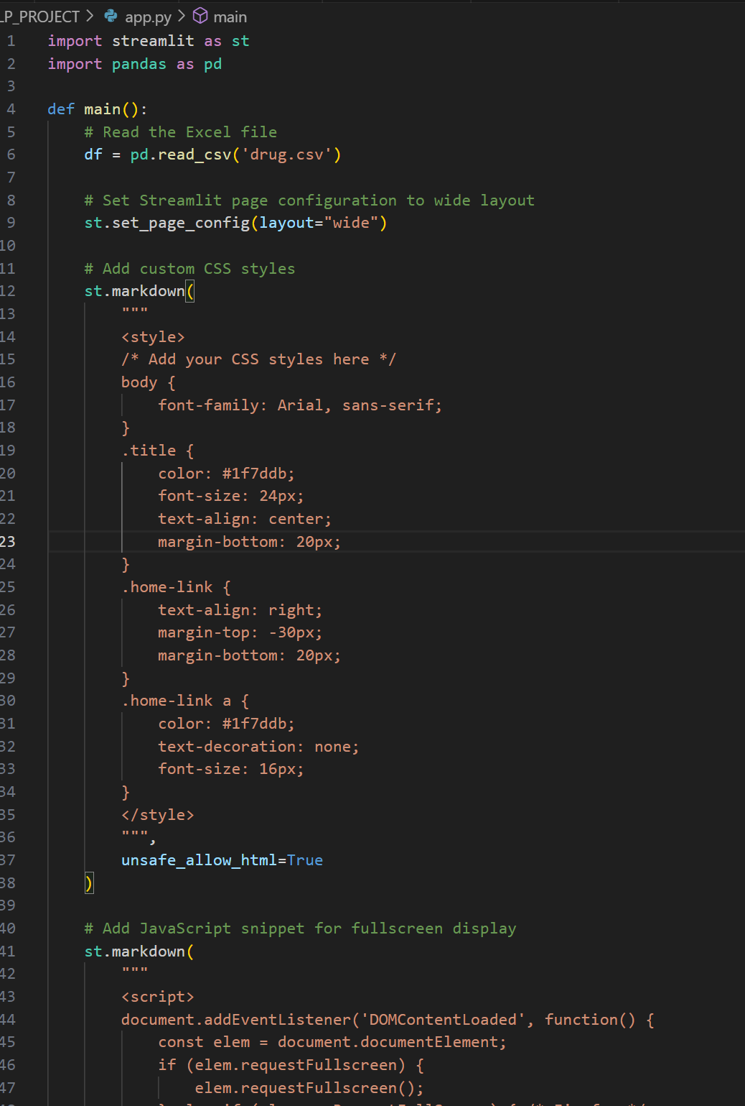
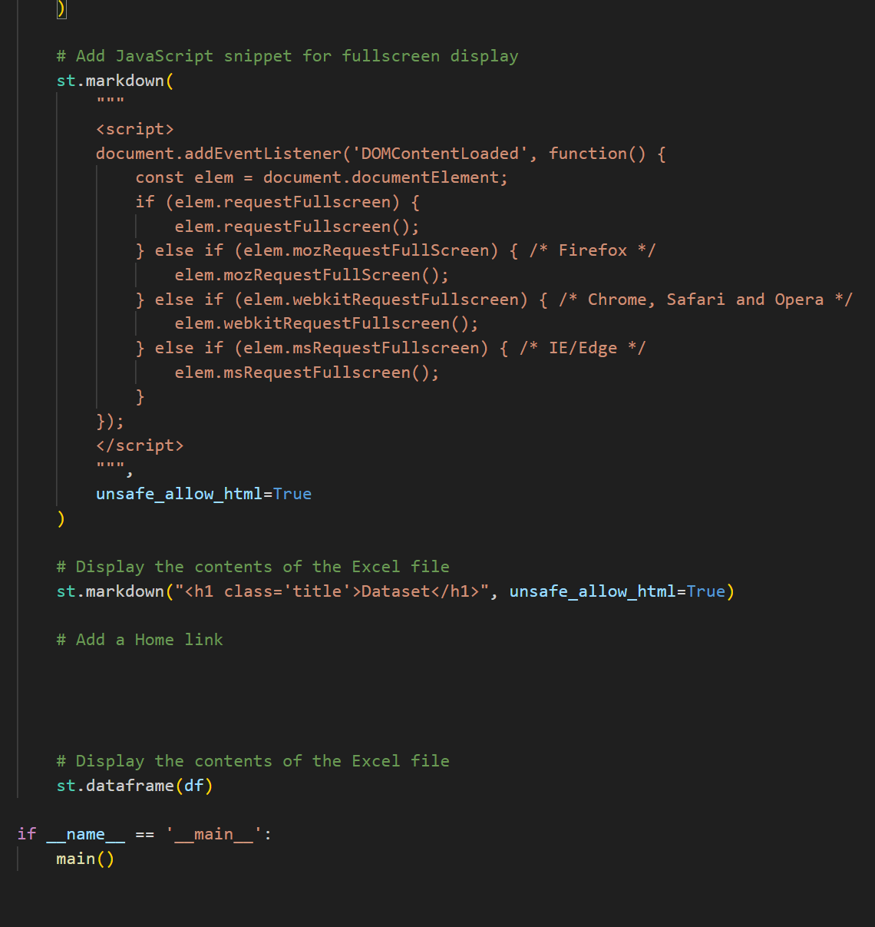
Implementation
Home page is done with HTML, CSS, JAVA SCRIPT. All reviews page is loaded with streamlit python code as following:

Slide 14
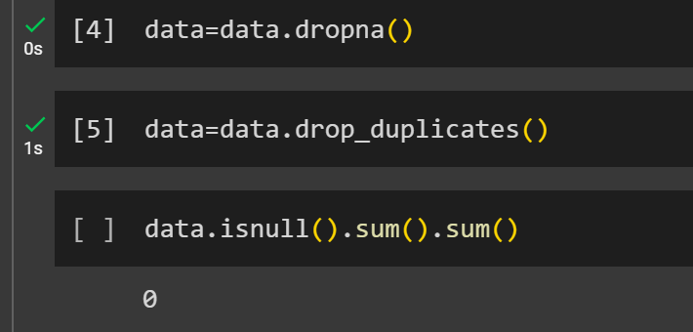
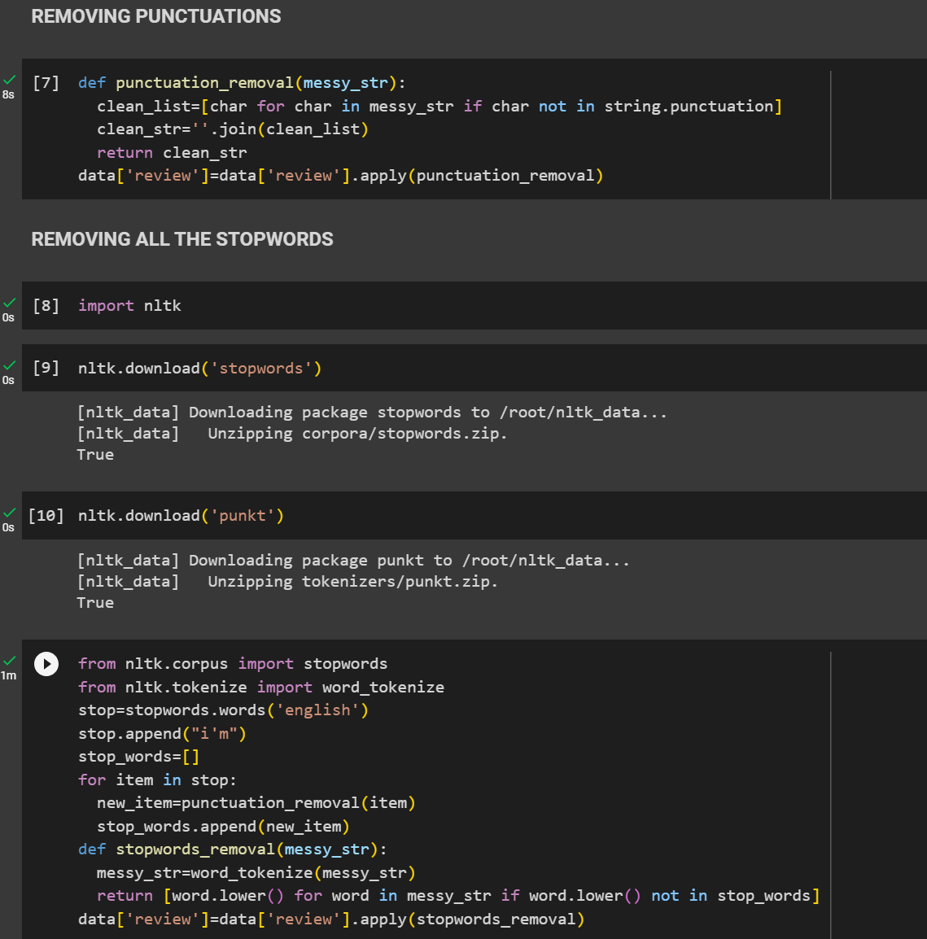
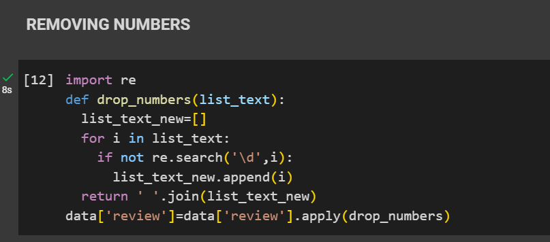
Implementation
Before working with the dataset, it should be cleaned(Dropping null values, Removing duplicates, stop words, Punctuations, Numbers). The python code as follows:

Slide 15
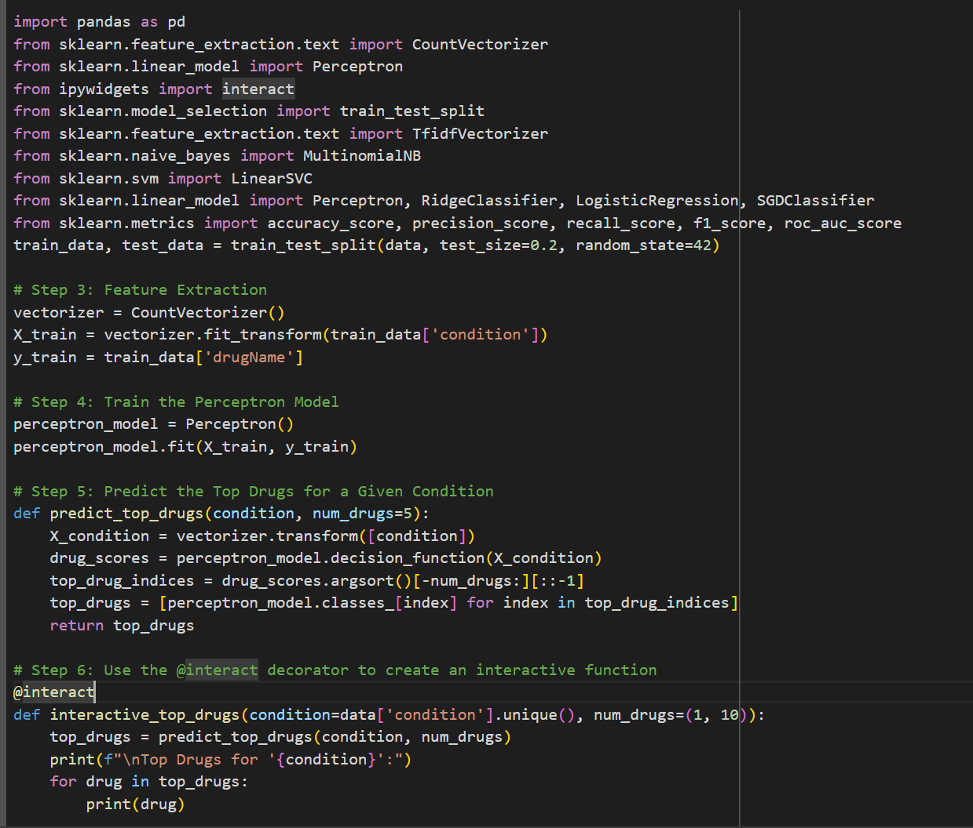
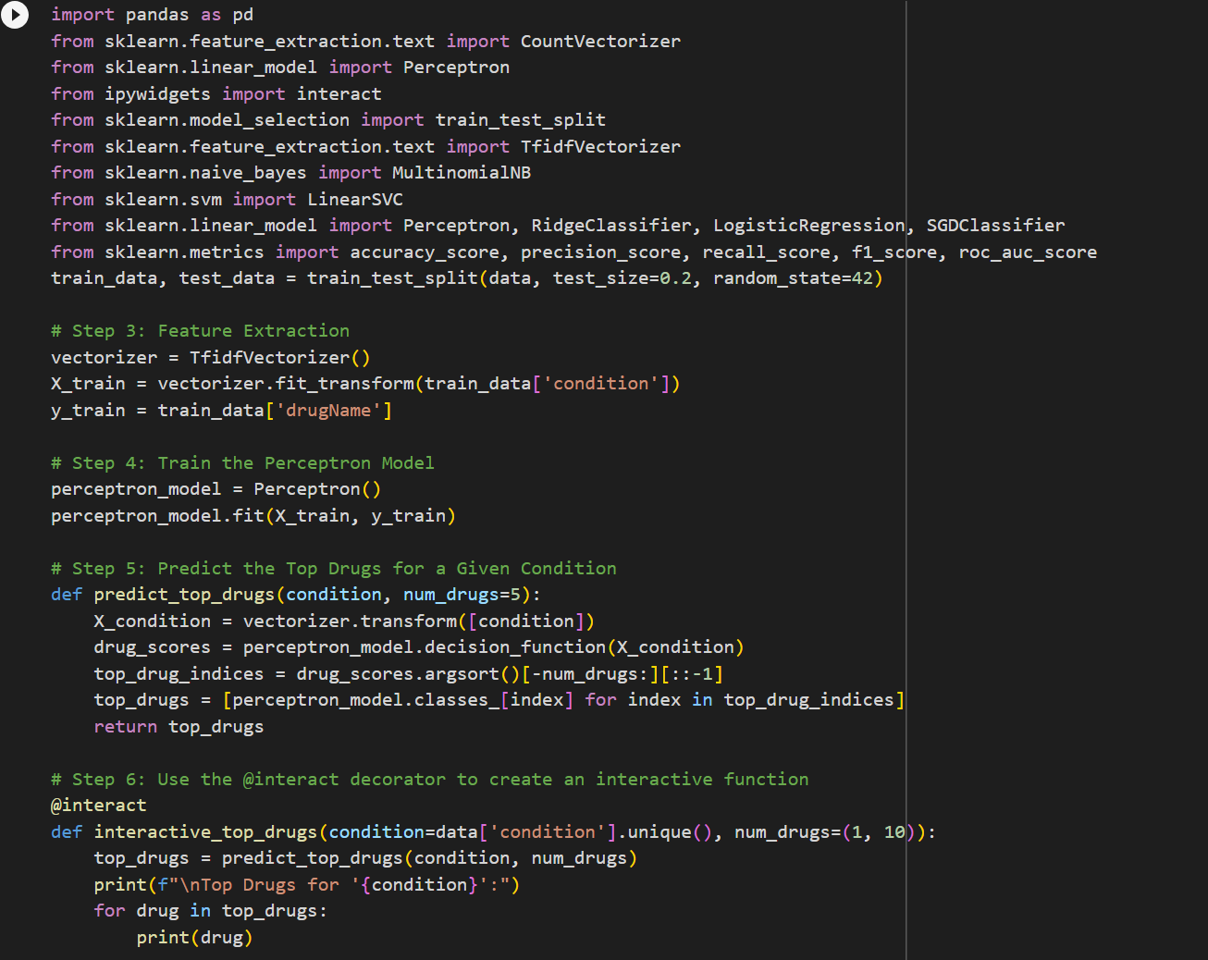
Implementation
For generating Streamlit code, it is done in python and then converted into Streamlit. The python code for
Perceptron(BoW) Perceptron(TF-IDF)

Slide 16
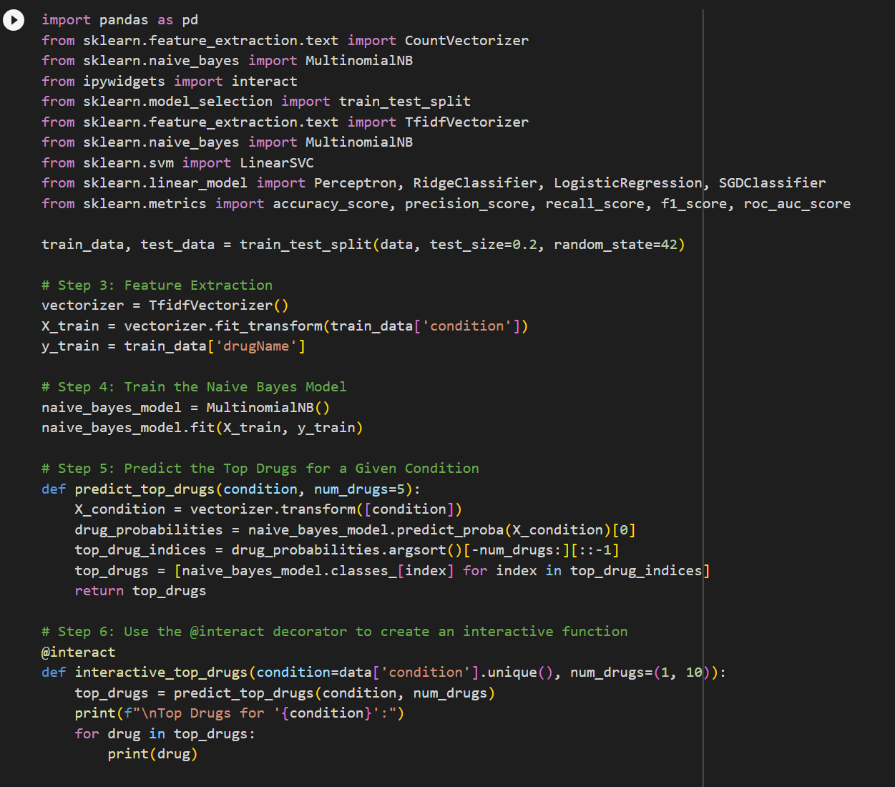
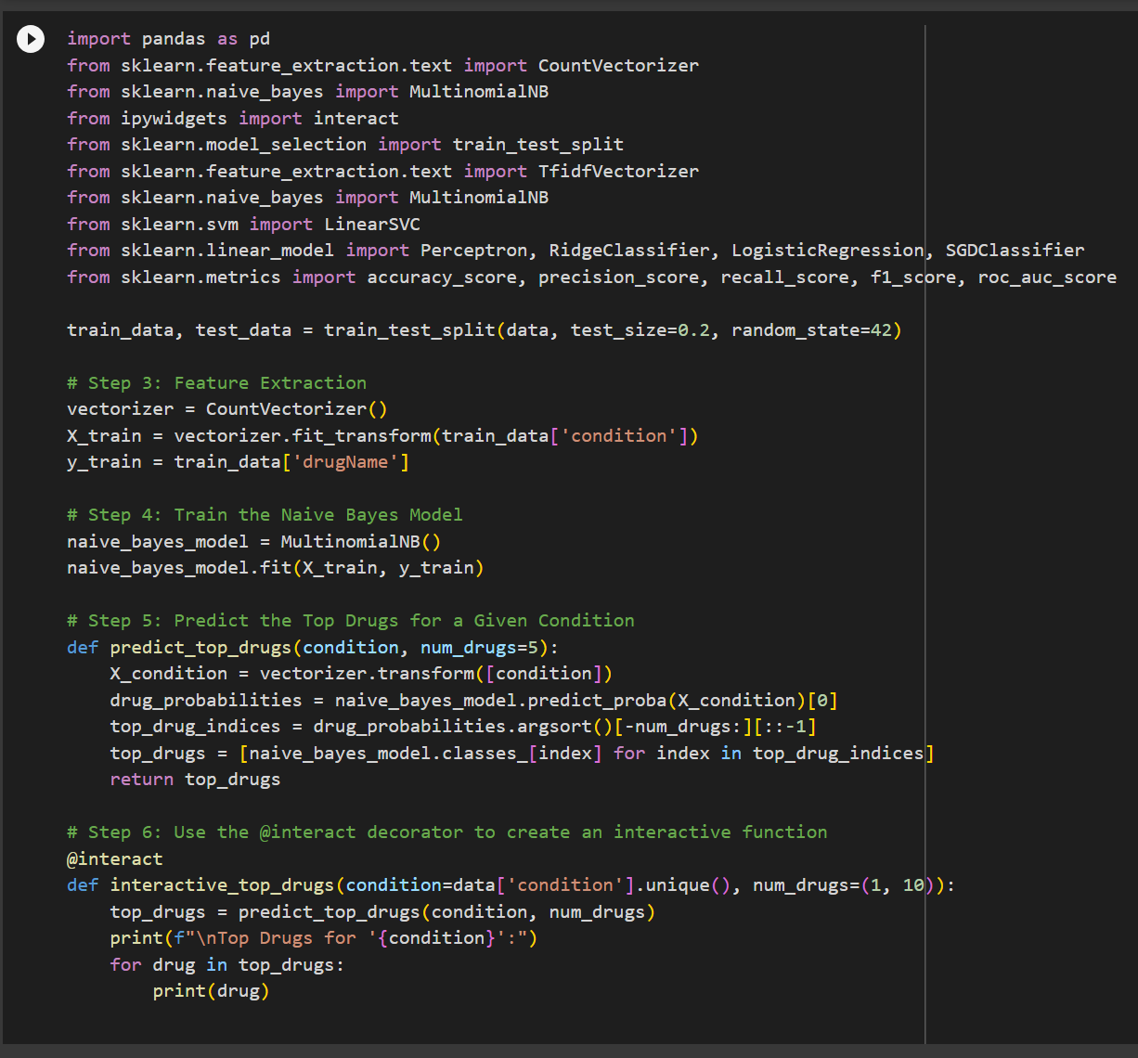
Implementation
Naive Bayes(TF-IDF) Naive Bayes(BoW)

Slide 17
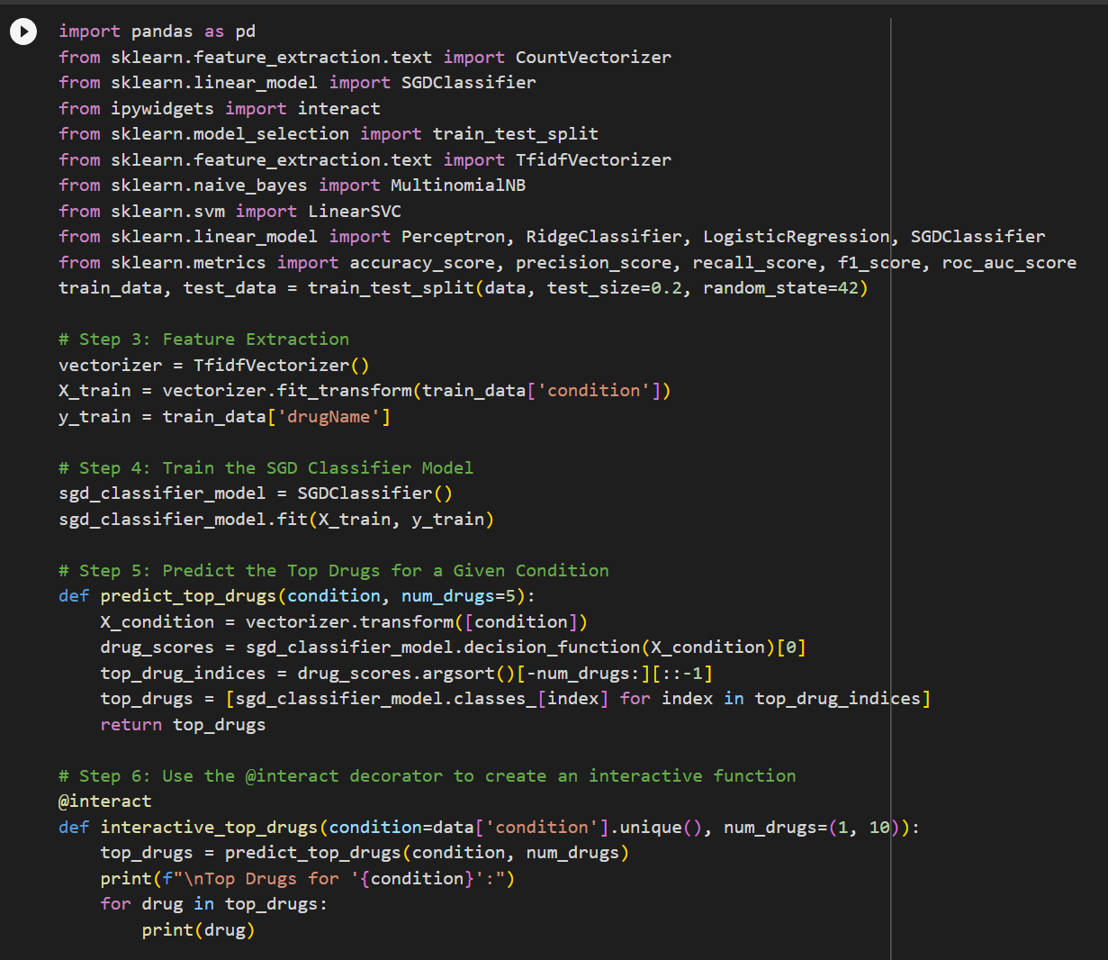
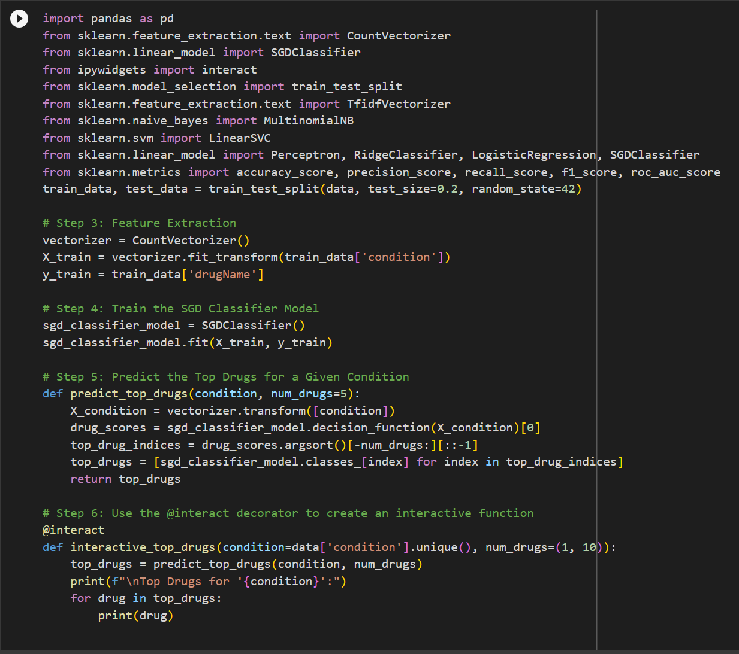
Implementation
SGD Classifier(TF-IDF) SGD Classifier(BoW)

Slide 18
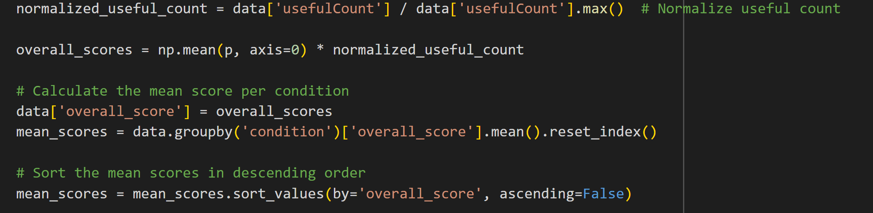
Implementation
The main intention is to make sure that the recommended top drugs should be classified correctly by all four models. If one model predicts it wrong, then the drug’s overall score will go down. These combined predictions were then multiplied with normalized useful count to get an overall score of each drug. The overall score is divided by the total number of drugs per condition to get a mean score, which is the final score.

Slide 19
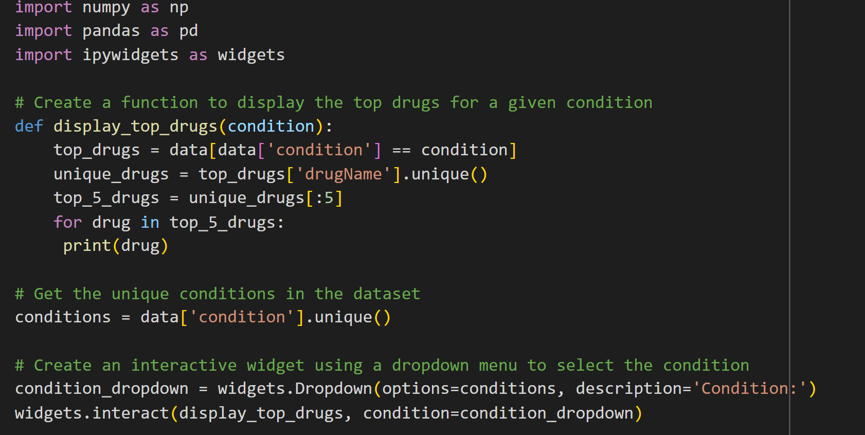
Implementation

Slide 20
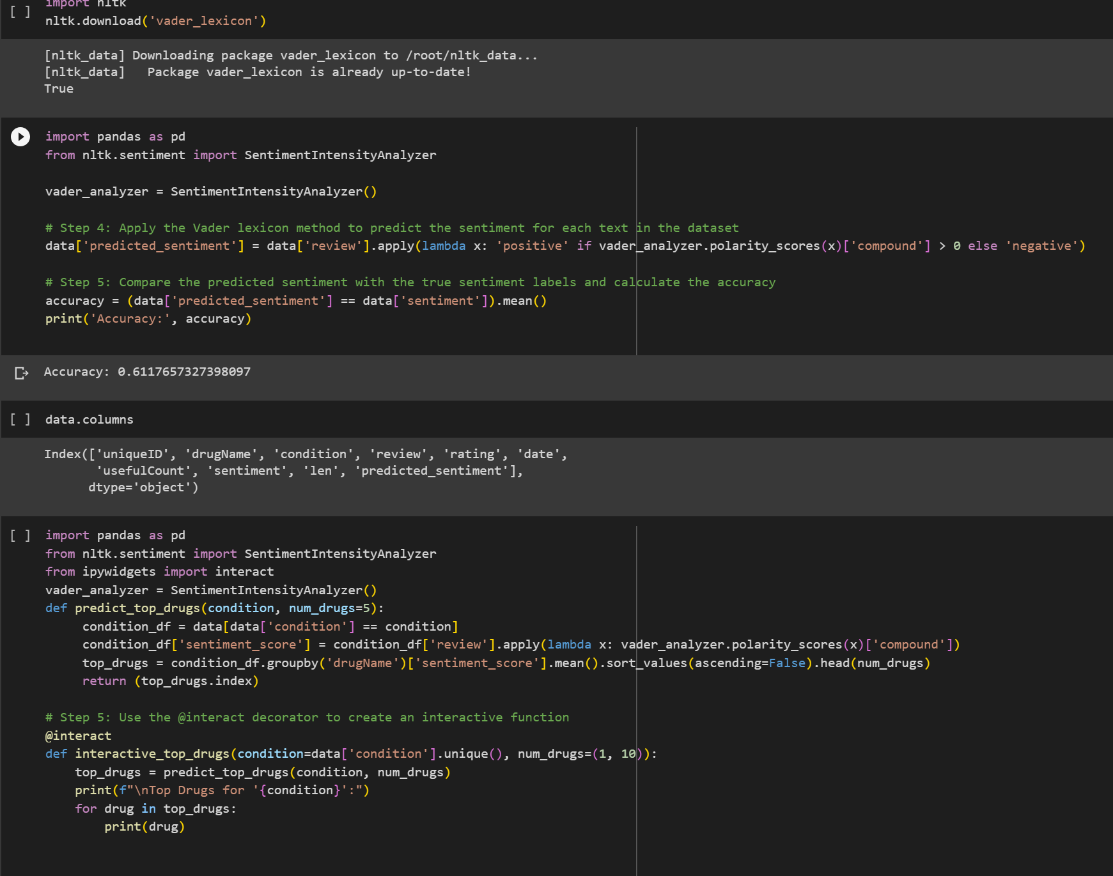
Implementation
Apart from Machine Learning Algorithms, We also tried out “Vader Lexicon” to train the model

Slide 21
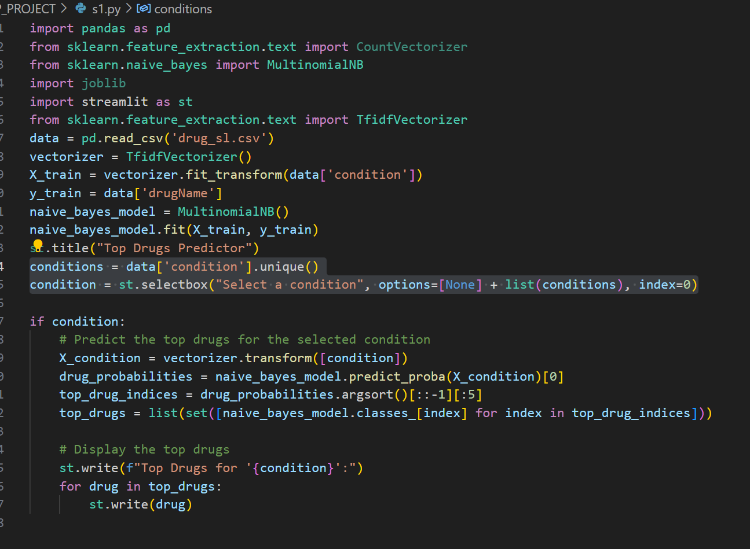
Implementation
Get Drug Recommendation page has an option to select a classifier. So, when Naive Bayes using TF-IDF is clicked, it shows the streamlit page that recommends top 5 drugs based on the Naive Bayes Classifier, the streamlit code for that page as follows:

Slide 22
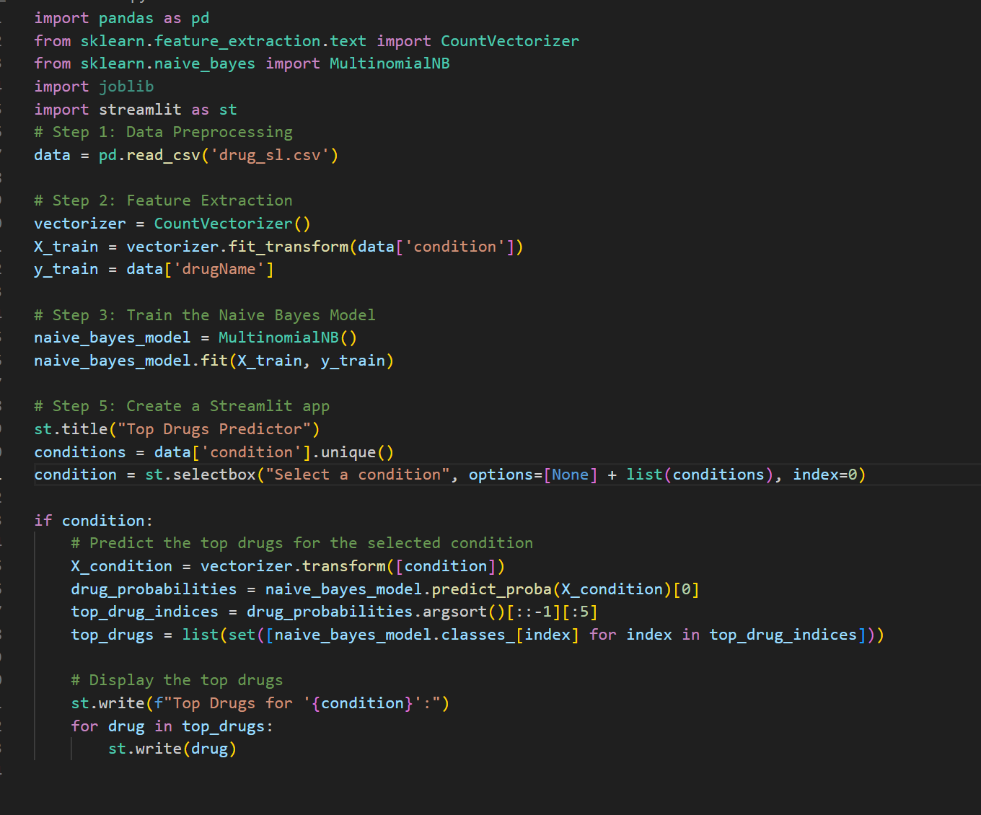
Implementation
Get Drug Recommendation page has an option to select a classifier. So, when Naive Bayes using BoW is clicked, it shows the streamlit page that recommends top 5 drugs based on the Naive Bayes Classifier, the streamlit code for that page as follows:

Slide 23
Implementation
Get Drug Recommendation page has an option to select a classifier. So, when All is clicked, it shows the streamlit page that recommends top 5 drugs based on the all classifiers(Naive Bayes, SGD Classifier, Perceptron Classifier, Logistic Regression, Linear SVC Classifier ), the streamlit code for that page as follows:

Slide 24
Implementation
Visualizations button has many options to choose .Since we tried many Machine Learning algorithms to train and test our data, we must compare all of them using some common metrics. We used Accuracy, Precision, Recall and F1 score to compare Machine Learning algorithms we used to train our data.

Slide 25
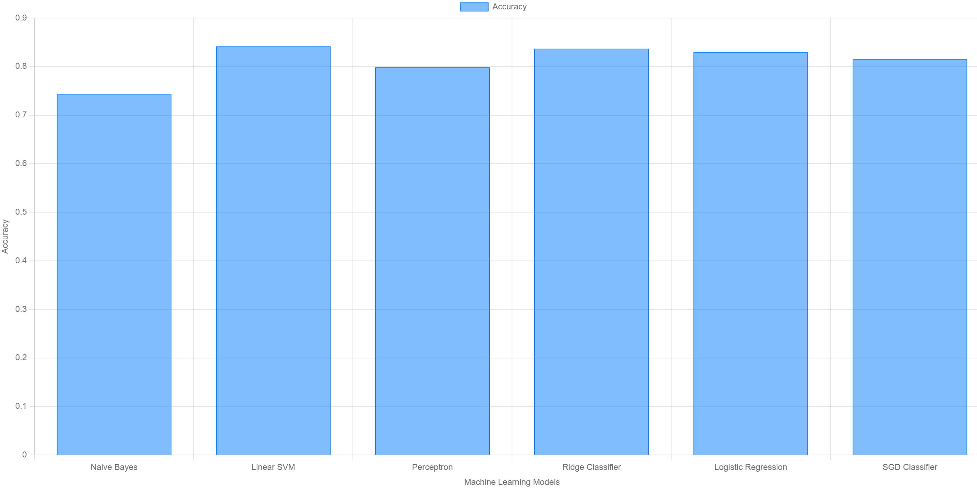
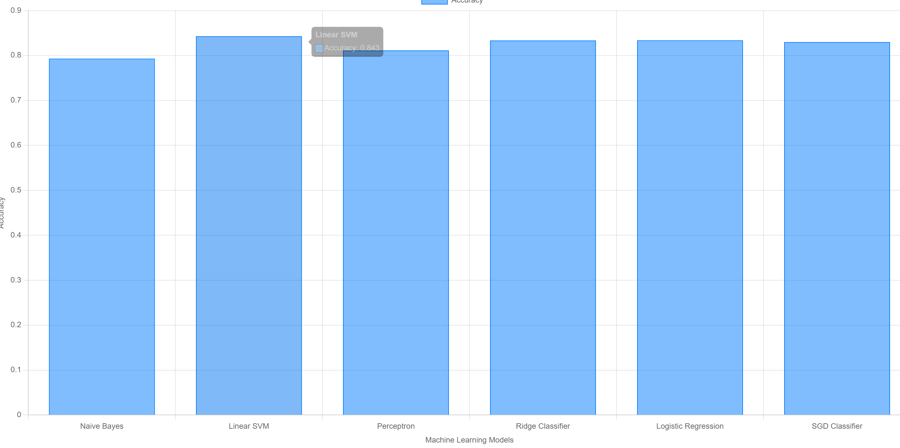
Accuracy Graphs
TF-IDF BoW

Slide 26
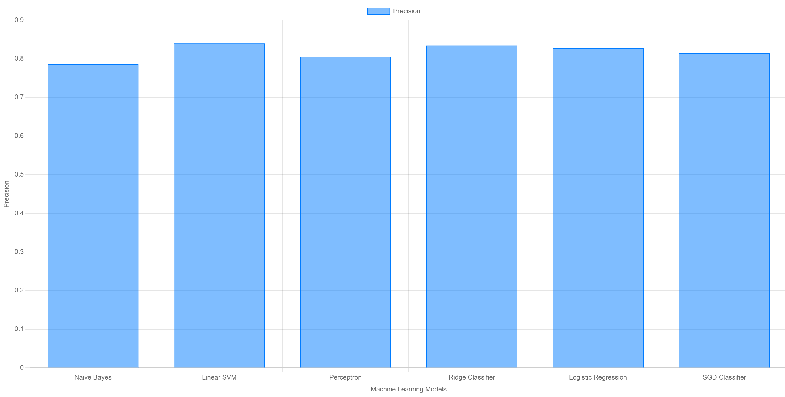
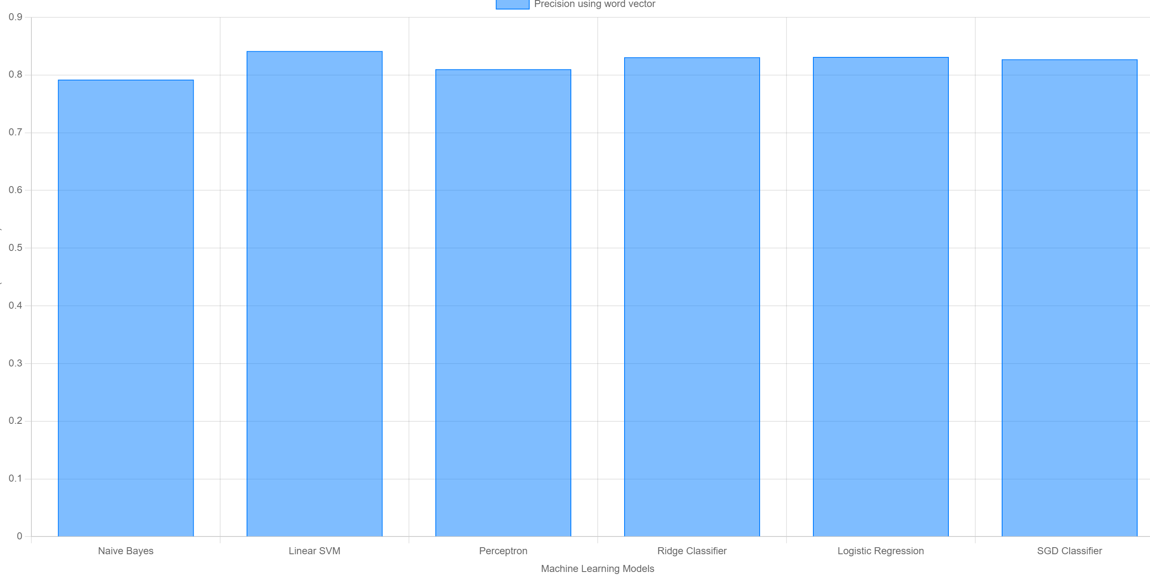
Precision Graphs
TF-IDF BoW

Slide 27
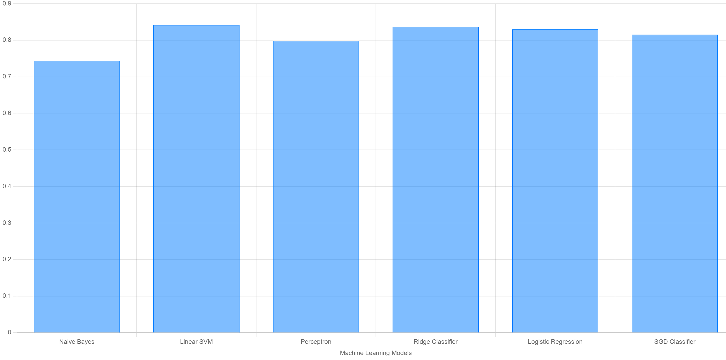
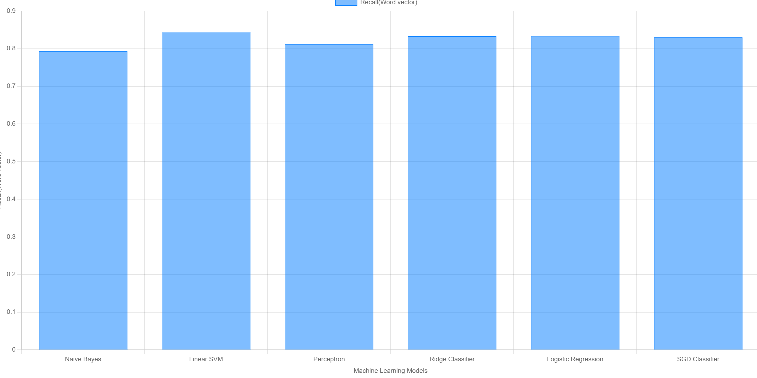
Recall Graphs
TF-IDF BoW

Slide 28
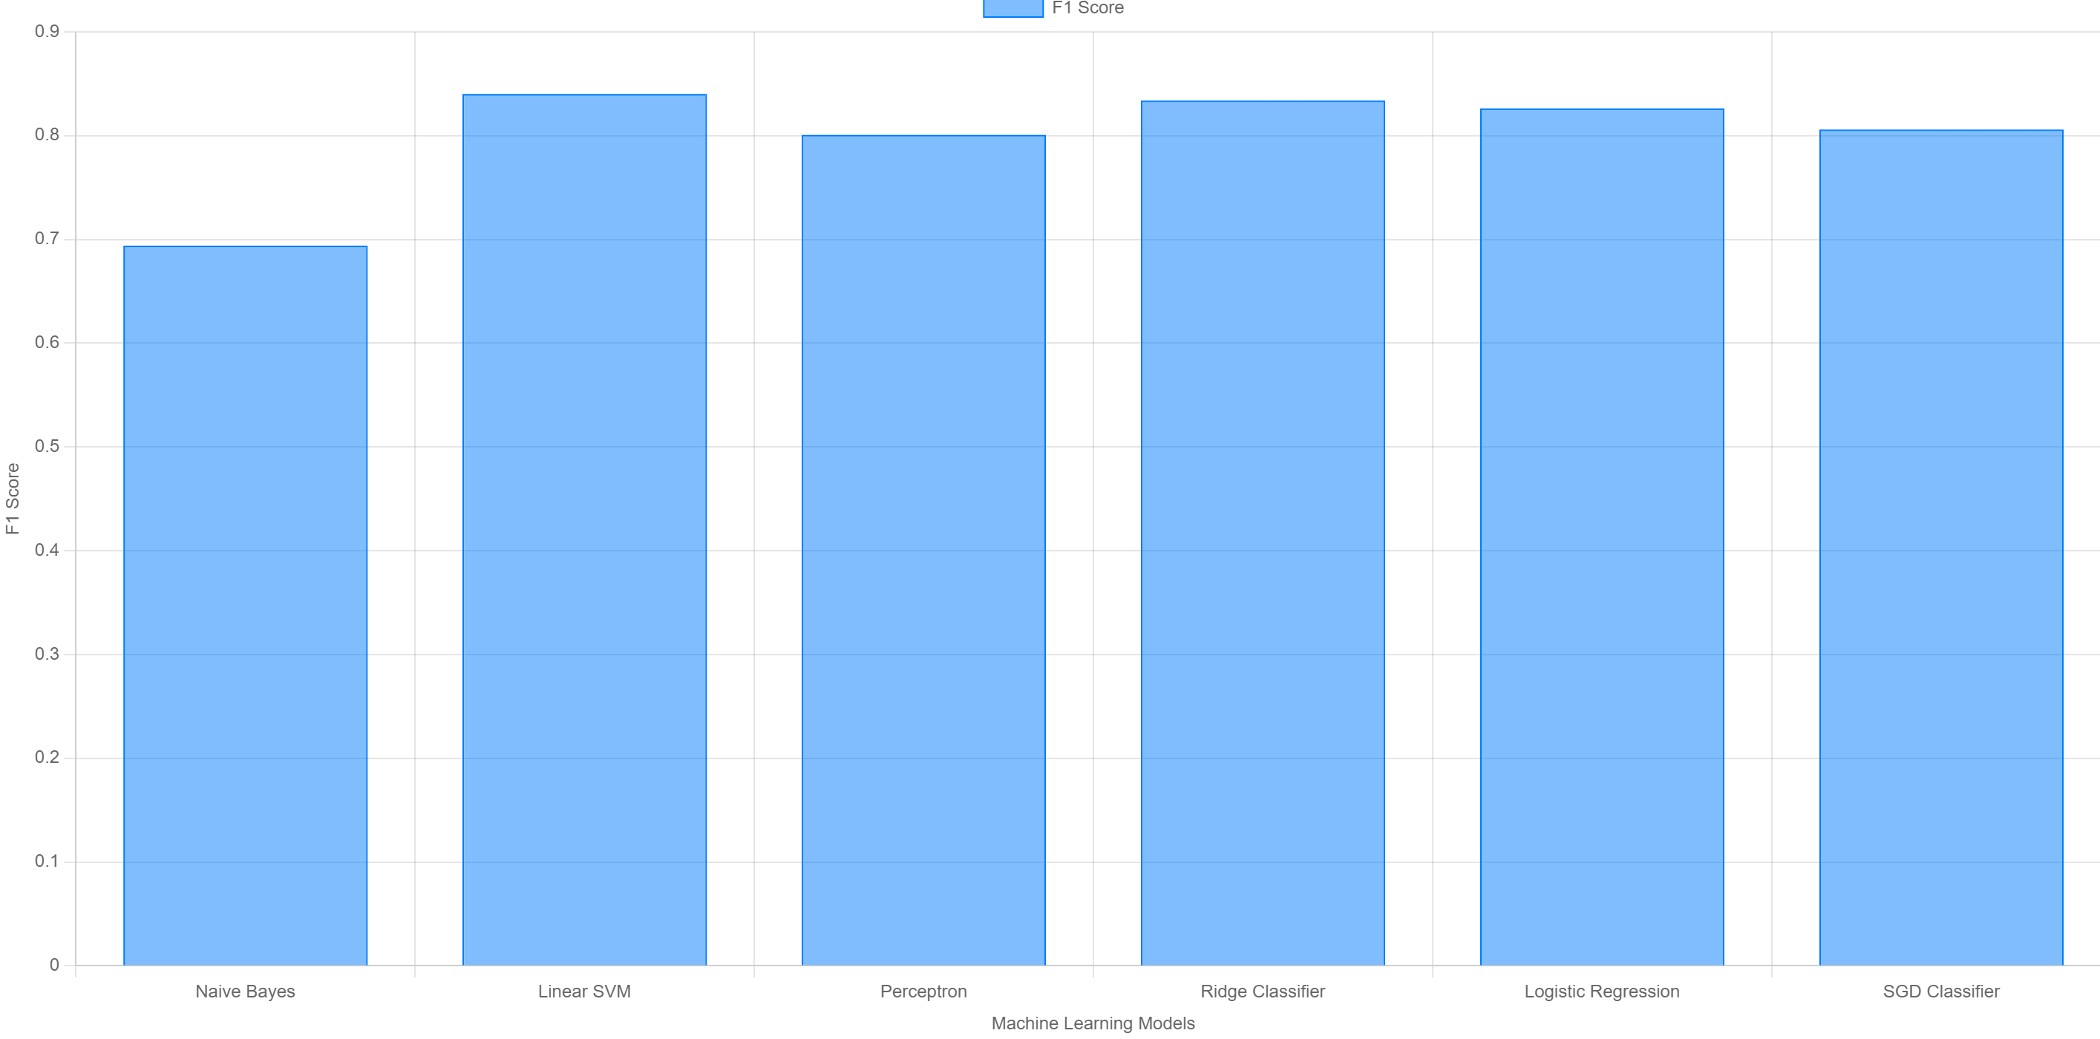
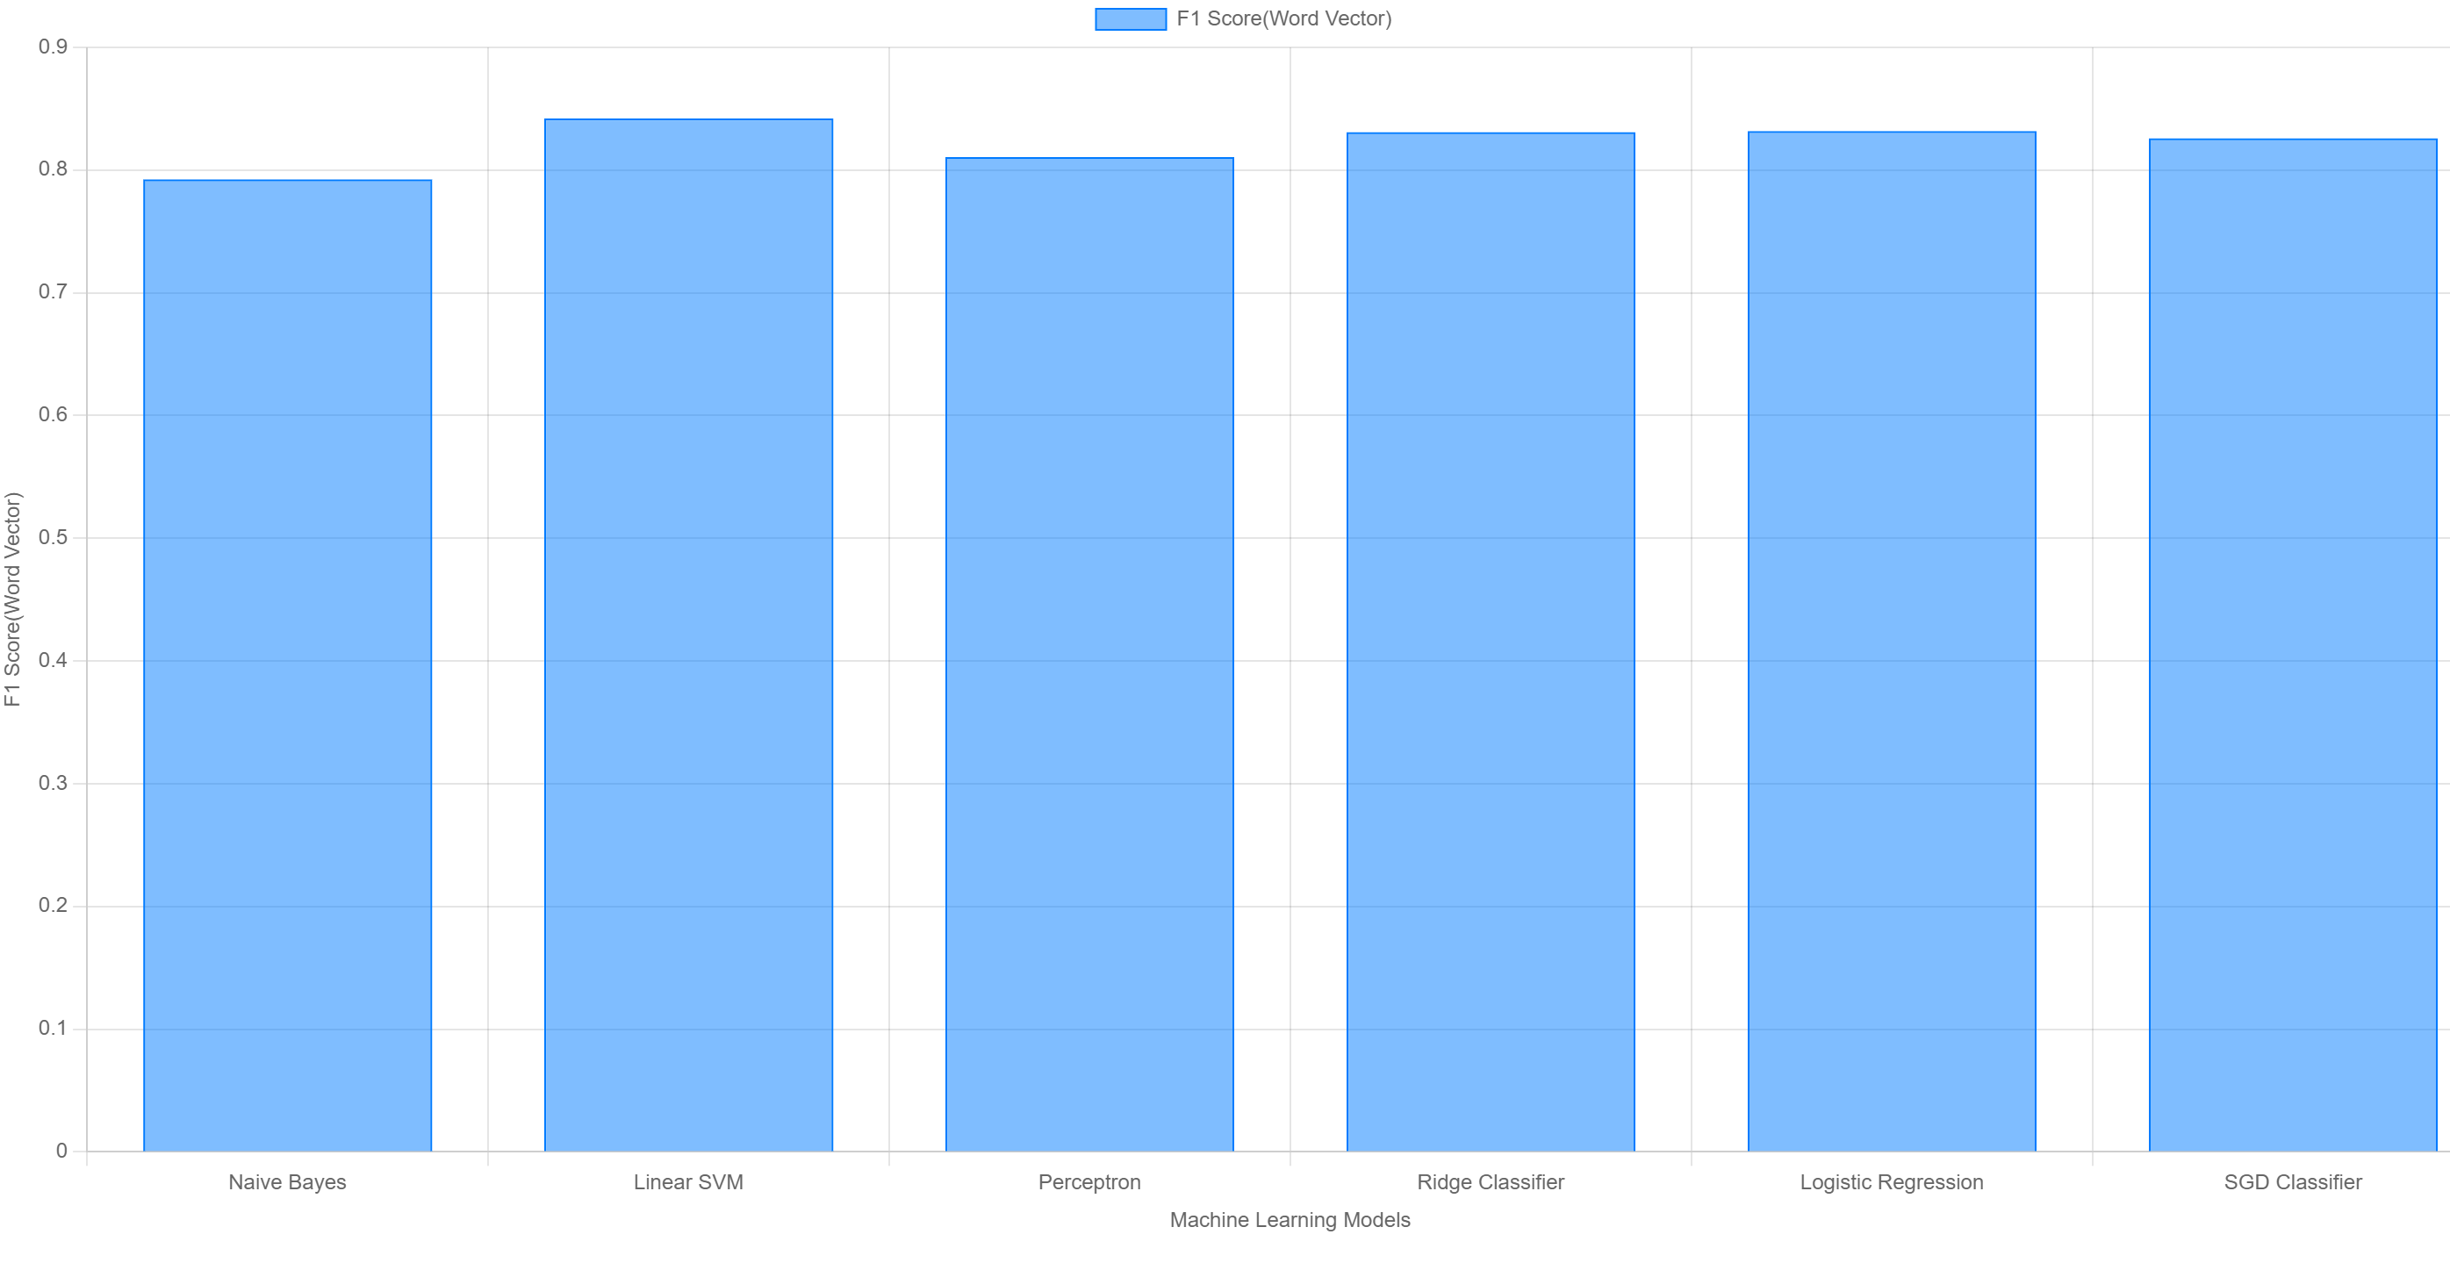
F1 score Graphs
TF-IDF BoW

Slide 29
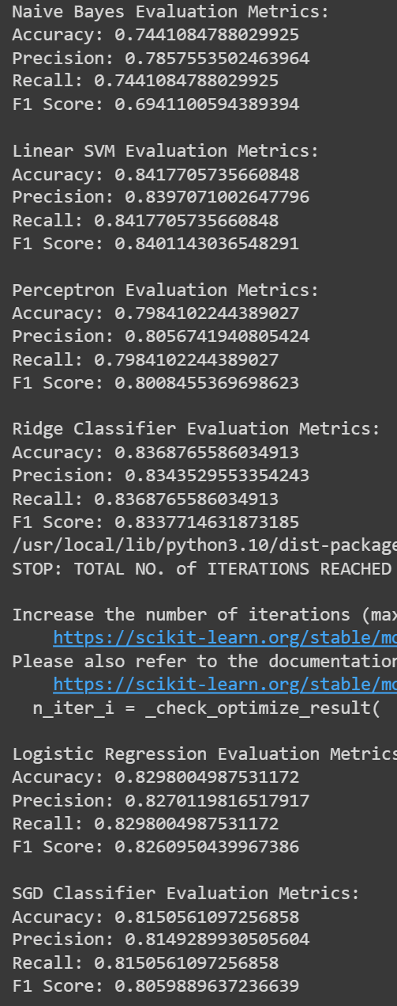
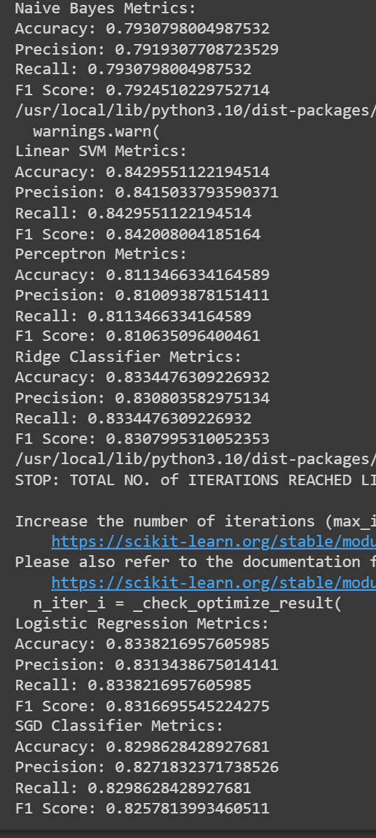
TF-IDF MODEL
TF-IDF MODEL BoW MODEL

Slide 30
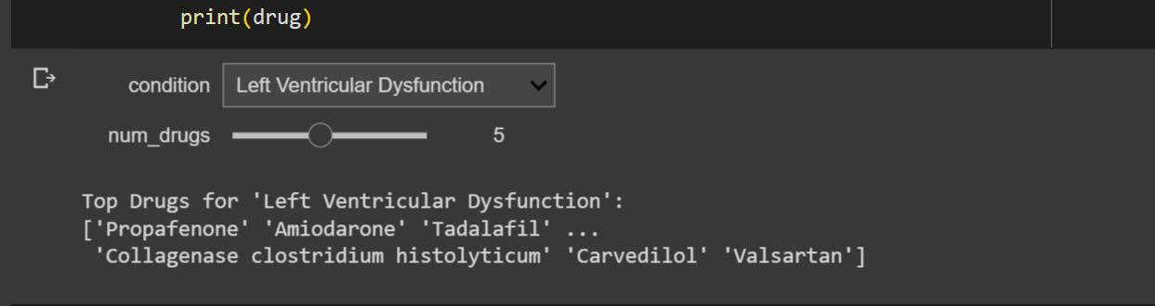
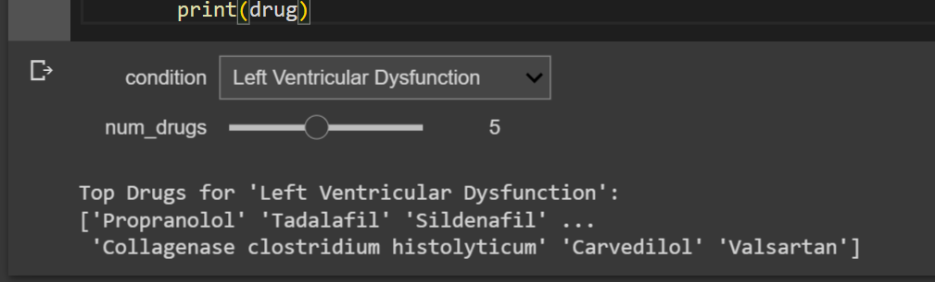
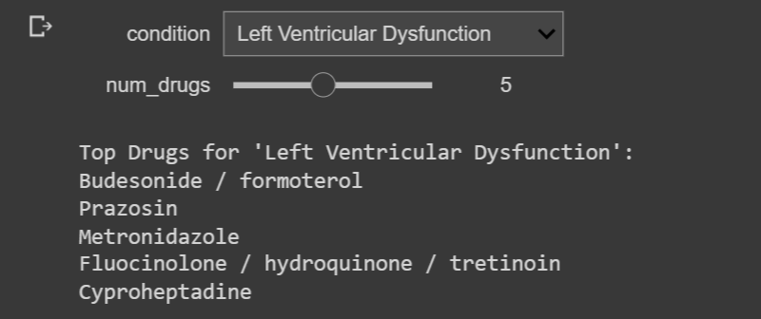
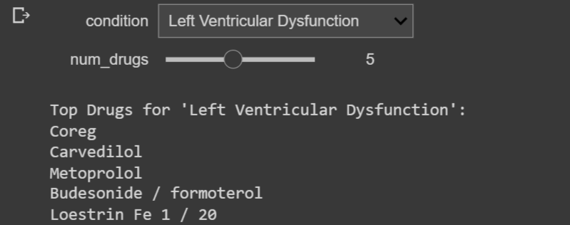
Testing
In Testing phase, we test our deployed models to predict the Top Drugs. We created an interactive drop-down menu in python which suggests top 5 drugs based on the condition.
Perceptron(TF-IDF) Perceptron(BoW)
SGD(TF-IDF) SGD(BoW)

Slide 31
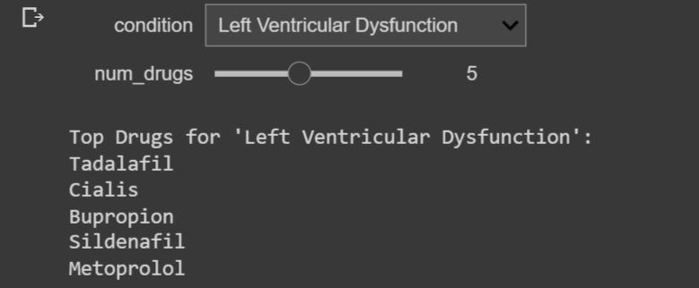
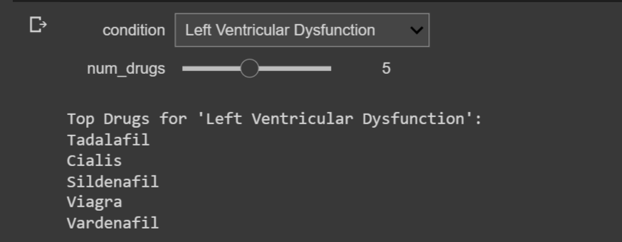
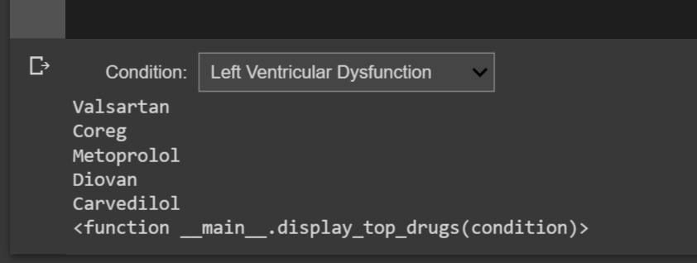
Testing
Naive Bayes(TF-IDF) Naive Bayes(BoW)
Using All Machine Learning Algorithms

Slide 32
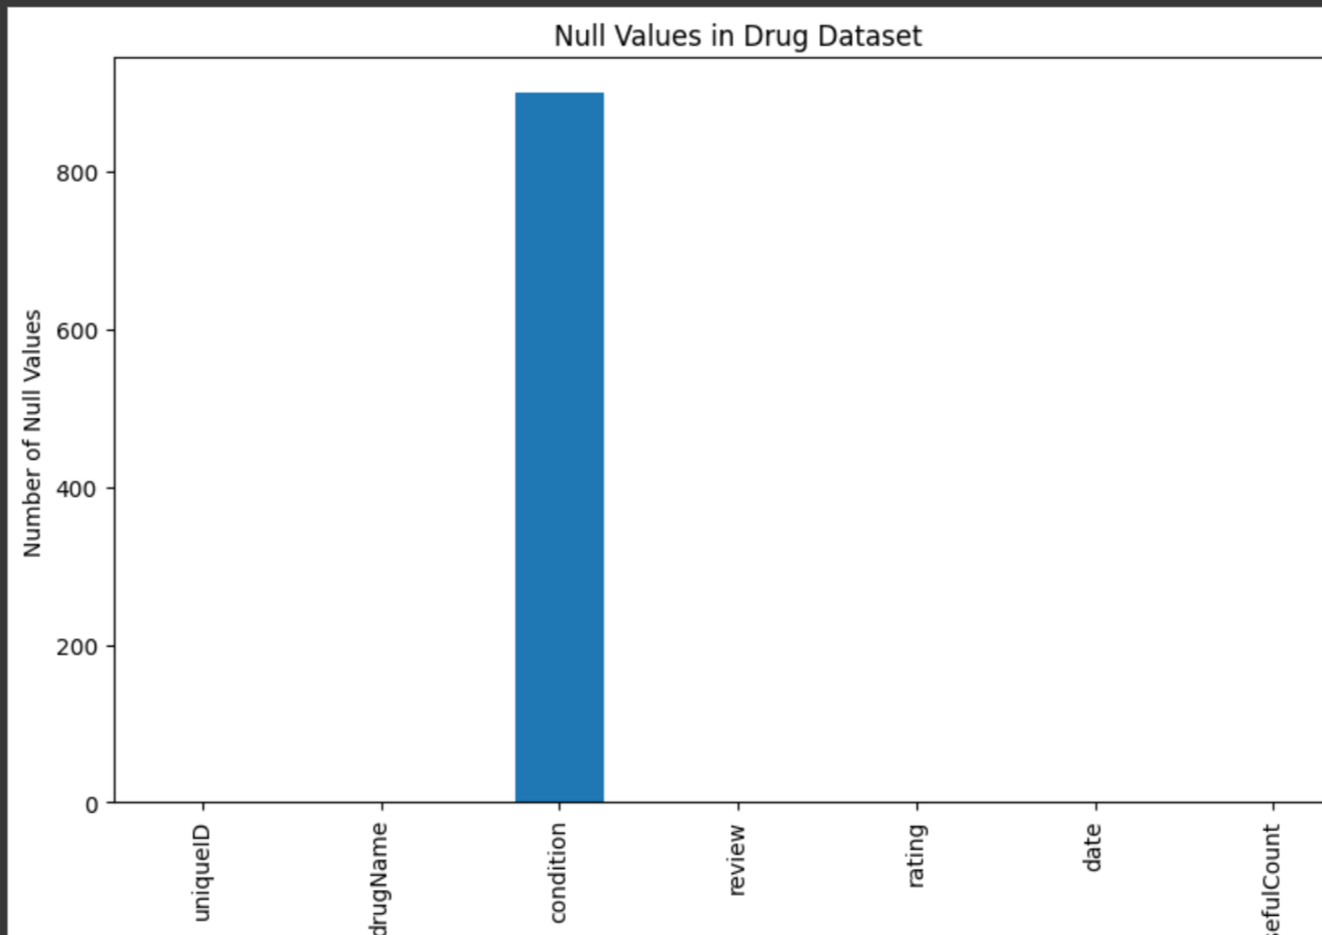
Result and Analysis
By this graph, only condition column has null values

Slide 33
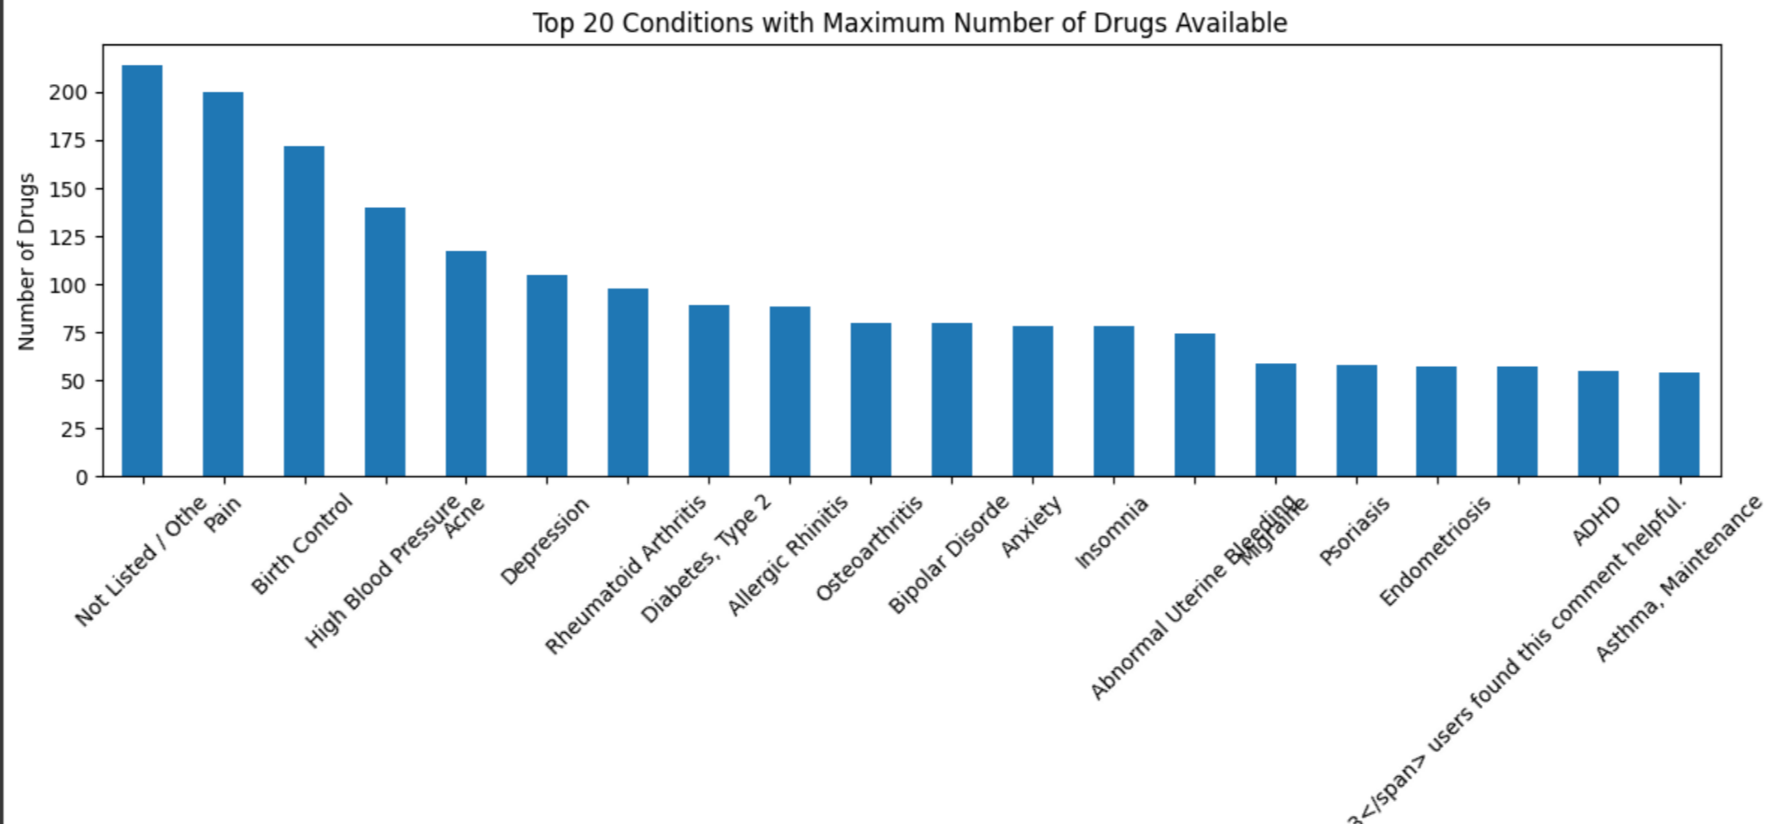
Result and Analysis
List of top 20 conditions with many drugs available

Slide 34
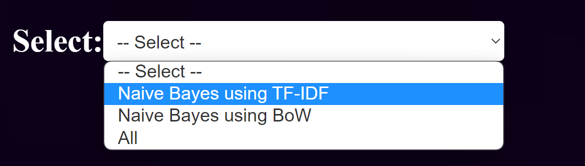
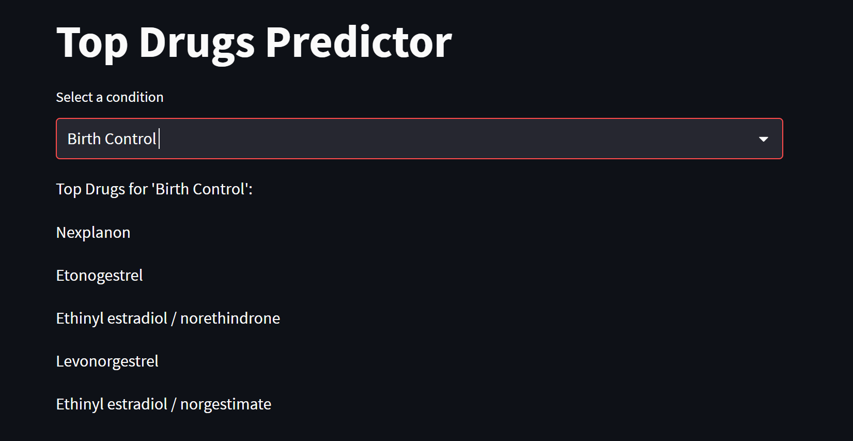
Result and Analysis
Recommendation

Slide 35
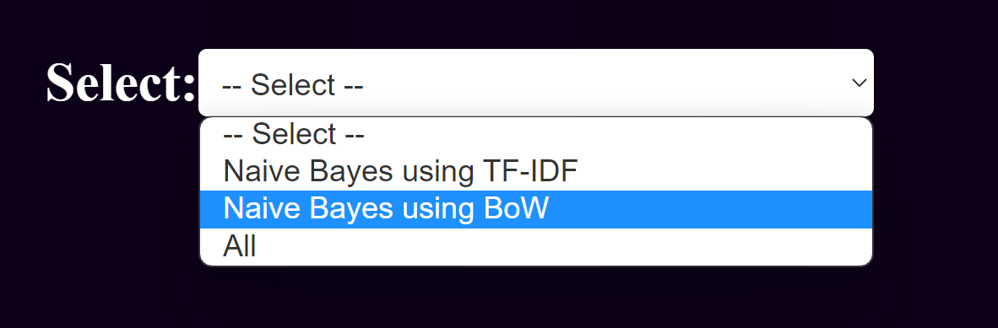
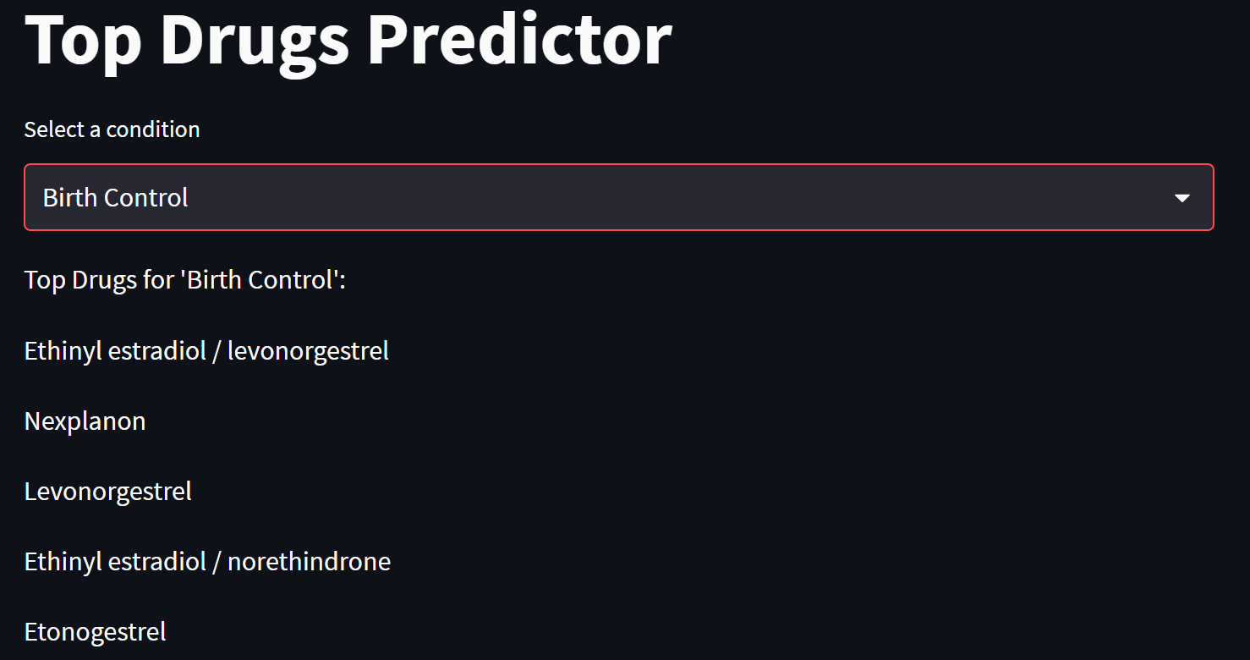
Result and Analysis
Recommendation

Slide 36
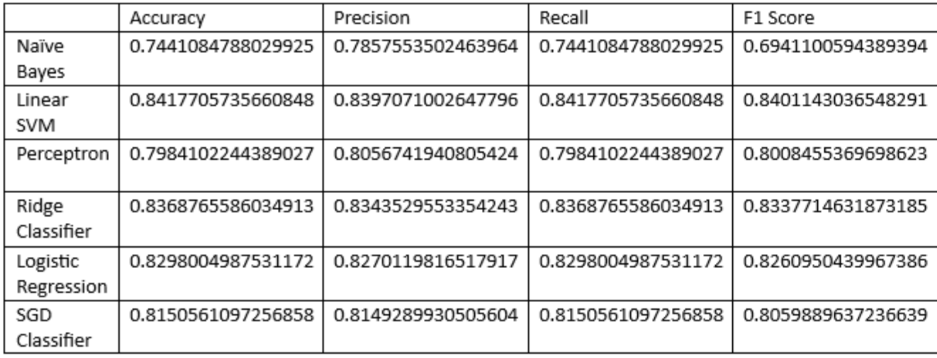
Result and Analysis
Tabular format for Classifiers when TF-IDF is used

Slide 37
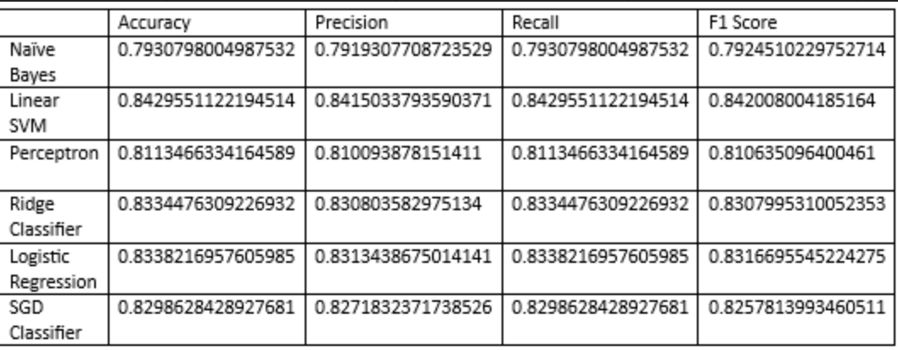
Result and Analysis
Tabular format for Classifiers when BoW is used

Slide 38
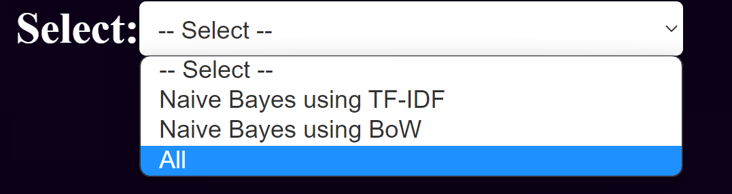
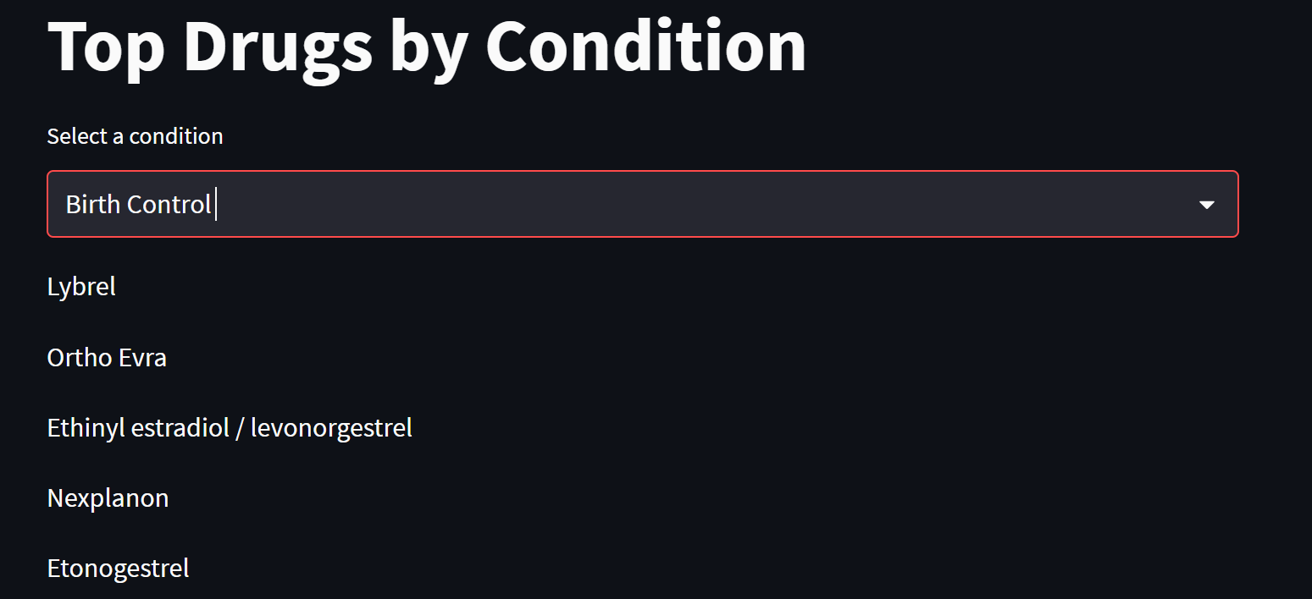
Result and Analysis
Recommendation

Slide 39
Result and Analysis
The reason why different machine learning algorithms may provide different results or predict different drugs is because each algorithm has its own way of learning patterns and making predictions.
We have implemented different machine learning algorithms such as Naive Bayes, Perceptron, and SVM etc.., Each algorithm has its own strengths and weaknesses and may make different assumptions about the data. These different approaches can lead to variations in the predictions made by each algorithm.
Additionally, the performance of each algorithm can be influenced by factors such as the quality and quantity of training data, the preprocessing techniques applied etc. Therefore, it is expected to see different drugs predicted by different machine learning algorithms.
It is important to evaluate and compare the performance of each algorithm using appropriate evaluation metrics to determine which one performs better for your specific task and dataset.

Slide 40
Demonstration
Demo need to be presented to the panel

Slide 41
Timeline
Abstract Submission
21-04-2023
Literature Survey
21-04-2023
Design [Front End, Back End]
< 25-05-2023
Implementation
< 31-05-2023
Testing
<1-06-2023
Document Submission
15-06-2023

Slide 42
Conclusion and Future Enhancements
The data set we chose is a very large dataset consisting of more than 1 lakh rows. So, it became very difficult to work with the dataset. Trial of n-grams, Word2Vec and even some Machine Learning algorithms took more time than expected. So, we would like to focus on that issue, how it can be resolved without any loss of data
We would also like to try out Collaborative Filtering on our data

Slide 43
Status of the project work Publication
Need to write the paper based on the work done which can be published in the Scopus indexed conferences or journals as per the direction of the guide

Slide 44
References
Satvik Garg. Drug Recommendation System based on Sentiment Analysis of Drug Reviews using Machine Learning. 2021 11th International Conference on Cloud Computing, Data Science & Engineering. 2021 IEEE.
Md. Deloar Hossain1 , Md. Shafiul Azam1 , Md Jahan Ali2 and Hakilo Sabit2 ,Drugs Rating Generation and Recommendation from Sentiment Analysis of Drug Reviews using Machine Learning. 2020 Emerging Technology in Computing, Communication and Electronics (ETCCE).IEEE.
C. Srinivasa Kumar, Ranga Swamy Sirisati, Viswanath Gudditti, Kanusu Srinivasa Rao, Ratna Kumari Challa. A Smart Recommendation System for Medicine using Intelligent NLP Techniques. Proceedings of the International Conference on Automation, Computing and Renewable Systems (ICACRS 2022).IEEE

Slide 45
References
4. Samayan Bhattacharya, Avigyan Bhattacharya, Sk Shahnawaz, Asraful Islam, DrugPal: A Machine Learning Based Drug Recommender System To Assist Physician, 2022 IEEE Students Conference on Engineering and Systems (SCES), July 01-03, 2022, Prayagraj, India.IEEE.
5. Theresa Olubukola Omodunbi, Grace Egbi Alilu, Rhoda Nsikanabasi Ikono, Drug Recommender Systems: A Review of Stateof-the-Art Algorithms, 2022 5th Information Technology for Education and Development (ITED).IEEE.

Slide 46
THANK YOU

